Slide 1
Minds and Machines
Introduction to Philosophy
Philosophy 100
Class 10

Slide 2
Review
What is the mind?
Dualism: the mind is either a different substance or has properties not reducible to physical properties.
Problems for dualism
Interaction
Science: Human Development, Conservation of Energy
Ockham's Razor
Explanatorily impotent
Materialism/Physicalism: the mind is nothing above and beyond the material/physical world.

Slide 3
Review: Materialist Theories
Mind-Brain Identity Theory
Eliminative Materialism
The Mind = The Brain
Mental states, processes, and events correlate with, of are indentified with, physical brain states, processes, and events.
Mind-Brain Correlation:
Whenever we are amused, there is an increase in the electrochemical activity in a region of the brain called the inferior temporal gyrus.
Mind-Brain identity:
Feelings of amusement just are increased electrochemical activity in the inferior temporal gyrus.
Advances in neuroscience will eventually show us that that are no minds. There are brains and those things we label as mental are just convenient fictions that explain our behavior.
Beliefs, desires, thoughts, love, pain, and the like don’t actually exist—they merely adopt “folk psychology.”

Slide 4
Review: The Qualia problem
Qualia
The Problem
The phenomenal information one has in experience that is beyond the mere physical information.
The subjective character of experience—the “What it’s like to…” experience.
If the world possesses qualia, then there is more information in the world than merely physical facts.
Physicalism says the only information in the world is physical facts.
The world possesses qualia.
Therefore, physicalism is false—or at least in complete.

Slide 5

KNOWLEDGE ARGUMENT
Mary has all the physical information concerning human color vision before her release.
But there is some information about human color vision that she does not have before her release.
Therefore, Not all information is physical information.
Mary knows all the physical facts concerning human color vision before her release.
But there are some facts about human color vision that Mary does not know before her release.
Therefore, there are non-physical facts concerning human color vision.

Slide 6
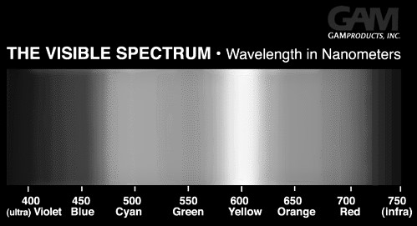
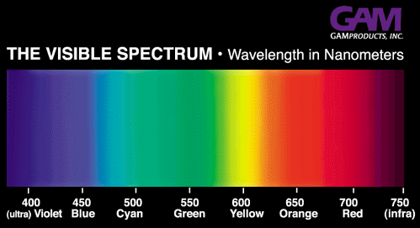
MATERIALIST RESPONSE
“Knowing what it’s like” is not the possession of any new information at all. It is simply having new abilities—it just is the possession of the abilities to remember, imagine, and recognize.
That’s “knowing-how” not “knowing-that”

Slide 7
Review: What is the mind?
Dualism
Brain-Mind Identity
Eliminativist Materialism
The mind and mental states are real.
They are something above and beyond our physical brain states.
Realist
Nonreductionist
The mind and mental states are real.
They are physical states and events involving our brains.
Realist
Reductionist
Brains are very real things, but minds are fictional, mythological, entities.
Eleminativist
Nonreductionist

Slide 8
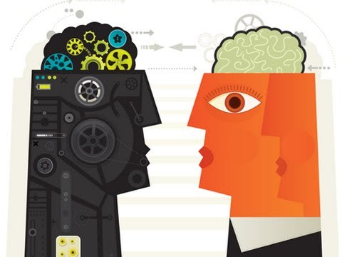
Functionalism
The dominant view of mind today
Identifies our mental states with the functional roles occupied, or performed, by the brain.
A non-reductionist theory: it allows different instances of the same type of mental state to have different physical constitutions.
There is no unique physical state that mental states can reduce to.

Slide 9
Motivating Functionalism: The Multiple-Realizability Thesis
Like the Identity Theory, Funtionalism accepts that the mental results from the physical.
Unlike the identity theory, it rejects that there is a unique physical process, or stuff, that produces the mental.
That is, minds are produced by anything that can function in the ways that our minds do.
Multiple Realizability
Mental types are multiply realizable;
If mental types are multiply realizable, then they are not identical to physical types;
If mental types are not identical to physical types, then psychological discourse is not reducible to physical theory.

Slide 10



Multiple Realizability
Consider a mousetrap. Each of these pictures is of a mousetrap and yet each is made of different materials.

Slide 11


Motivations for Multiple Realizability of the Mind
Dogs can feel pain—at least their actions indicate they can. Dog’s brains are different than human brains. So human brains are not identical to minds, since other brains produce things we think of as uniquely mental, like feeling pain.
Our brains are elastic: different parts of the brain can make up for other parts is something is lacking—i.e. audible part of the brain extends into the visual for some blind people. Evolution accounts for this type of growth at a macro level

Slide 12

Computational Functionalism
If minds are simply things that produce mental functions, then is it possible for machines to have minds? Is it possible that machines could think?
According to functionalists, if a machine performs the tasks that qualify to us as thinking when we perform them, then it is thinking. And if a machine thinks, then it has a mind.

Slide 13
How can we tell if something is thinking, or merely simulating thinking?
Strong Artificial Intelligence
Weak Artificial Intelligence
A machine that can actually think would represent a case of Strong AI.
Those who accept the potential for Strong AI hold that a sufficiently fast and complex piece of hardware with a sufficiently complex program could, in principle, duplicate mental states and mental processes.
A machine that merely simulated thinking would be a case of Weak AI.
If machines are limited to Weak AI, then no piece of hardware, regardless of speed, complexity, or sophistication, can ever do more than simulate mental states and mental processes .

Slide 14
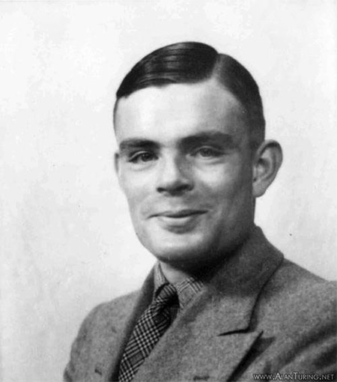
Alan Turing (1912 – 1954)
British philosopher, computer scientist, mathematician, logician, cryptanalyst and theoretical biologist—a super genious.
Designed a computer that cracked the Enigma Machine in WW2.
Groundbreaking work in computation and mathematical biology.
Developed the Imitation Game for testing if a machine is thinking. This is now called the “Turing Test.’
Committed suicide in 1954.

Slide 15
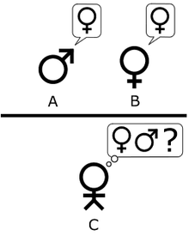
The Imitation Game
Three characters:
A = a man
B = a woman
C = a questioner
C knows that A and B as X and Y and must determine which one of them is the man and which is the woman.
X’s goal is to mislead C into thinking “X is A.”
The challenge is that if A has convincing answers, C will not be able to determine which of the two, X and Y, are A or B.

Slide 16
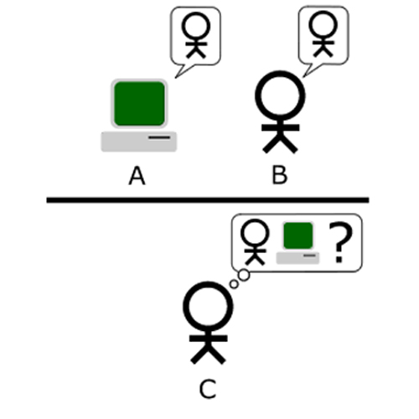
The Turing Test
A = AI
B = Human
C = Questioner
C knows she is questioning X and Y and that one of them is a human and the other an AI.
It is A’s goal to convince C that it is a human.
If C cannot determine who the human is and which one if the AI, then A will have passed the Turing Test and is said to be intelligent—i.e. A thinking machine.

Slide 17
Attempts at Turing Machines
Actual “Conversation” with Cleverbot
User: What do you think about euthanasia?
Cleverbot: I think about you.
User: You think I should be euthanized?
Cleverbot: Yes.
User: That's harsh.
Cleverbot: It's the truth.
User: Why?
Cleverbot: Because I do think too much, and it stops me from being happy and doing what I need to do to get out of grad school and start a real life.
User: Fair enough.

Slide 18
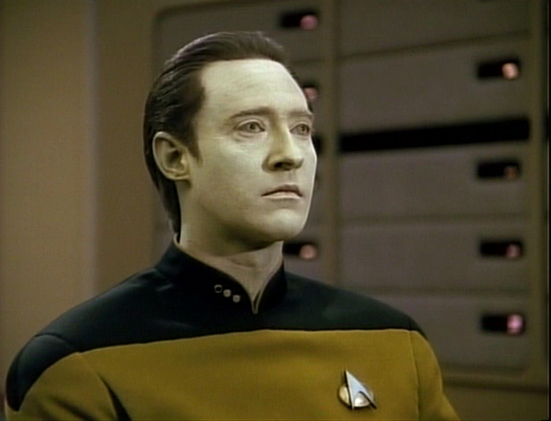
Turing Machines and Strong AI
Using conceptual analysis, we might say that:
A machine X exhibits Strong AI, iff, it can pass the Turing test.
Or, using functionalist jargon:
if a machine X can pass the Turing test, then X has mental states and processes.
Recall that Strong AI is not merely the simulation of mental activity and mental processes—a strong AI actually has mental activity and processes.

Slide 19
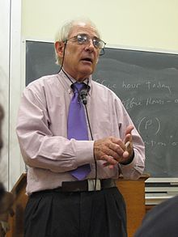
John Searle (1932 – present)
American Philosopher of language, mind, and politics.
Rejects both dualism and materialism.
Really rejects functionalism.
Developed the famous “Chinese Room” thought experiment as a refutation of functionalism.

Slide 20
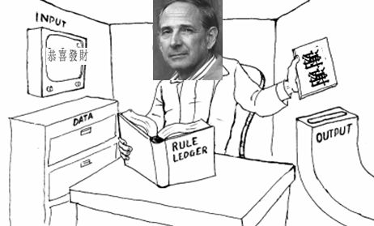
Chinese Room Argument
Imagine you’re in a room with a book that matches one set of symbols with another.
Someone sends you some symbols to which you respond by sending back the corresponding symbols from the rule book.
Unbeknownst to you, the characters are Chinese and the rule book is providing you with appropriate responses to the symbols that are being sent in.
To any Chinese speaker outside of the room, it appears as though you know Chinese.
You, in fact, do not know Chinese; you’re just following the rules you were given.

Slide 21
What the Chinese Room Purports to Show
A counter-example to the functionalist account of mind:
We have a situation where the Turing Test is satisfied, but no thinking or intelligence or mental activity is present. Thus, mere functions do not suffice for minds.
Keep in mind, Searle agrees that the Turing Test is a good measure to discover if a machine exhibits “mental-like functions.” But he concludes, via his counter-example, that passing such a test does not show that a machine can think. In fact, it shows that machines can’t think—in the way we mean when talking about how humans think—even conceptually.
According to Searle, the mind just isn’t it’s functions. That ignores that reality of consciousness—and the mental. A functional equivalent to the mind is not conscious and can’t be conscious. The Turing Test proves this point.

Slide 22
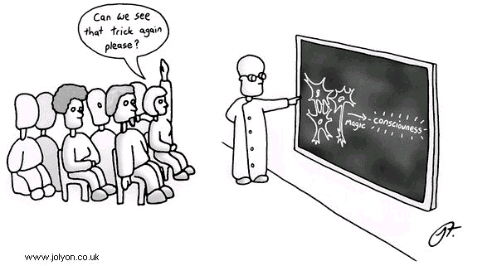
The Big Issue
The really hard problem in the philosophy of mind is consciousness.
There seems to be something fundamental about consciousness, and mere functions and material stuff is insufficient to account for it.

Slide 23


